Slide 1
FTTH Conference 2018
The Socio-Economic Benefits of FTTH
Dr. Iris Henseler-Unger 13th February 2018

Slide 2
Around 20 million FTTH/B subscribers in Europe
Penetration at Sept 2017
The number of FTTH/B subscribers in the EU28 has grown more than fourfold since the last FTTH Council Europe study on socio-economic benefits of FTTH.
Scandinavian and Baltic countries lead the way with regard to current penetration of FTTH/B.
FTTH/B pioneers Sweden and the Netherlands were selected to trace the socio-economic effects of fibre in the present study.
< 1%
> 1%
> 5%
> 10%
> 20%
> 25%
100%
Source: IDATE DigiWorld 2017

Slide 3
Sweden – An FTTH success story
PTS data
WIK survey data
2nd FTTH Council study
1st FTTH Council study
additional sample
Source: Data for 2007 to 2016 was taken from the Swedish Post and Telecom Authority (2017); data for 2017 was collected via a representative consumer survey conducted for this study, N=803. To harmonise both data sets other Internet access technologies (e.g. satellite, dial-up, etc.) were not considered in the figure above.

Slide 4
Our Goal:
Identify the socio-economic benefits of FTTH
Our Methodology:
Representative survey of 1018 Swedish consumers
Case Study in Sweden
Case Study in the Netherlands

Slide 5
Agenda
Consumer Survey Results
Case Study Sweden
Case Study Nuenen (NL)
An Outlook
Summary

Slide 6
Consumer Survey Results

Slide 7
Overview of the study
To understand the socio-economic benefits of FTTH in Sweden a representative survey of Swedish consumers was conducted by the international market research institute YouGov between 29 September 2017 and 2 October 2017.
The final sample size was 1018 consumers. A detailed overview of the sample is provided at the end of this report.
Methodology: CAWI (computer-aided web interview).
The results were weighted to draw representative conclusions for the Swedish population (age 18+).
The questions revolved around consumers’ Internet service providers (ISPs), the access technology used, their level of satisfaction, typical online activities and socio-demographics. For the purposes of comparison we draw on the data gathered for the study on the socio-economic effects of FTTH conducted in 2009 by the FTTH Council Europe (n=167) and representative data collected in Sweden in 2014 (n=1122). The latter survey was also conducted by YouGov on the same panel using the same methodology as for the present study.

Slide 8
Faster access in high demand
The share of Internet subscribers with contracts that give them 100 Mbit/s or more increased by 32 percentage points from 2014 to 2017.
Conversely, the share of broadband connections providing downloads at less than 100 Mbit/s strongly decreased between 2014 and 2017.
Share of Internet connections by download speed offered in the contract
5
6
%
of broadband contracts since 2014 have been FTTH
Source: Representative consumer survey (2014, 2017); 2014: N=1122; 2017: N=924.

Slide 9
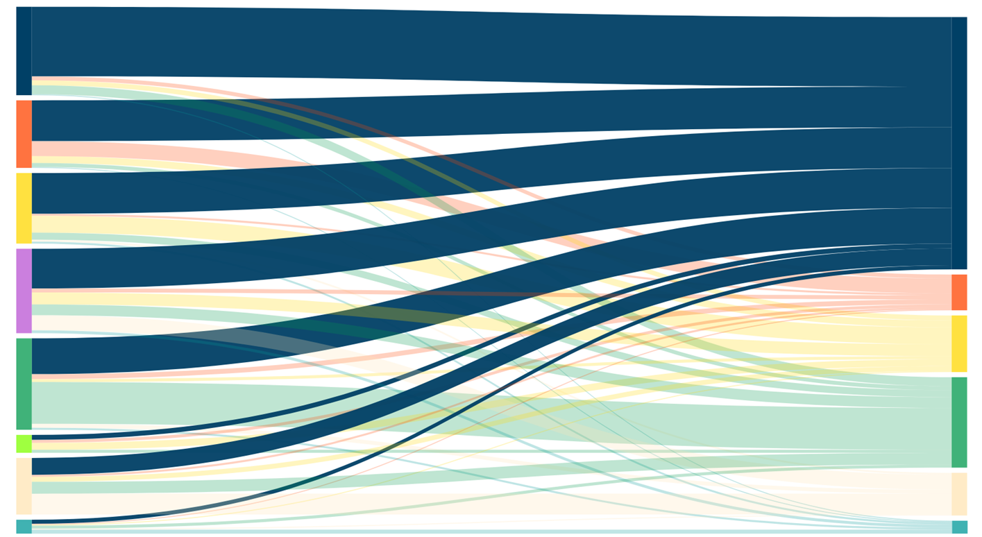
Swedes migrate to FTTH
Share of Internet connections by access technology (Sweden)
FTTH (18%)
DSL (14%)
FTTH (51%)
Cable modem (14%)
First subscribers (17%)
DSL (7%)
Cable modem (12%)
Wireless access (19%)
Wireless access (18%)
Dial up (4%)
Not sure (12%)
Not sure (9%)
Other (3%)
Other (3%)
2013
2017
Source: Representative consumer survey (2017), N=439.

Slide 10
Fibre makes a difference
More than 70% of those who made the switch to fibre noticed a difference to their previous Internet access technology.
For the majority of FTTH users fibre is about higher speed and better value for money.*
74%
* Percentage share of the maximum available points in a ranking exercise. Source: Representative consumer survey (2017), N=347.
Source: Representative consumer survey (2017), N=181

Slide 11
…in love with their FTTH connections
8
7
3
%
5
2
%
FTTH
2
%
cable
DSL
satisfied customers
Source: Representative consumer survey (2017), N=924; in Sweden; Sum of “Ilike it very much” and “It’s above average” on 5-point Likert-scale

Slide 12
Consumers want fibre
Only 13% of non-FTTH users claim that they have consciously decided against an FTTH subscription.
94% of non-FTTH users would consider subscribing to FTTH if it was made available in their area.
Source: Representative consumer survey (2017), N=417.
Source: Representative consumer survey (2017), N=157.

Slide 13
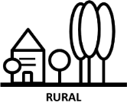
Rural areas catching up
Share in % of Internet connections 100Mbit/s or more and area type (Sweden)
60
59
2014
47
2017
35
14
15
6
3
Source: Representative consumer survey (2014, 2017); 2014: N=1122; 2017: N=924.

Slide 14
82% of rural households with 100 Mbit/s use FTTH
Proportion of Internet connections offering download speeds of 100 Mbit/s or more on optical fibre by area (Sweden)
78%
82%
76%
66%
SUBURBAN
SEMIRURAL
RURAL
URBAN
Source: Representative consumer survey (2017), N=924.

Slide 15
Always on
FTTH users are more likely to be online daily. They can therefore gain more frequent benefits from the reduced search and transaction costs that the Internet offers.
As the following slide illustrates, FTTH users are also more active on the Internet:
FTTH users access public service sites more frequently than non-FTTH users.
FTTH users stream music and video more frequently than non-FTTH users.
FTTH users employ the Internet’s information resources to find the best offers as well as general information more frequently than non-users.
They also spend more time surfing than non-FTTH users.
89%
Proportion of FTTH users who use the Internet daily
Source: Representative consumer survey (2017), N=924.

Slide 16
FTTH users do more online
On average FTTH users are
1
1
more active online.
%
Source: Representative consumer survey (2017), N=924

Slide 17
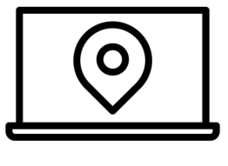
FTTH users do more online
Information
Entertainment
+ 7%
+ 15%
Social Interaction
Local Services
+ 15%
+ 10%
Source: Representative consumer survey (2017), N=924; Icons (clockwise): i cons, mikicon, Musmellow, Ema Dimitrova.

Slide 18
FTTH users still more active
From 2009 to 2017 the usage of high-bandwidth online services increased substantially in Sweden.
The strongest recorded growth is for downloading apps and software as well as online video consumption.
FTTH users were more likely to use high-bandwidth online services than non-FTTH users both in 2009 and in 2017.
The largest difference between FTTH users and non-FTTH users is in relation to downloading apps and video consumption.
FTTH
CAGR of FTTH: 10.3%
CAGR of FTTH: 2.1%
CAGR of FTTH: 12.2%
CAGR of FTTH: 1.4%
Non-FTTH
CAGR of FTTH: 8.6%
Video (e.g. Netflix, YouTube, IPTV)
Downloading applications, software, games, music or videos
Listening to radio
Downloading and uploading photos
Video telephony
Proportions of users of various high-bandwidth online services in 2009 and 2017
Source: FTTH Council Europe (2009) and representative consumer survey (2017), N=924.

Slide 19
FTTH users use more mobile devices than non-FTTH users
Proportions of users owning specific mobile devices connected to the Internet
Source: Representative consumer survey (2017), N=924; Significance: *** 0.01, ** 0.05, *0.1.

Slide 20
…the same goes for stationary devices
Proportions in % of users owning specific stationary devices connected to the Internet
Source: Representative consumer survey (2017), N=924; Significance: *** 0.01, ** 0.05, *0.1.

Slide 21
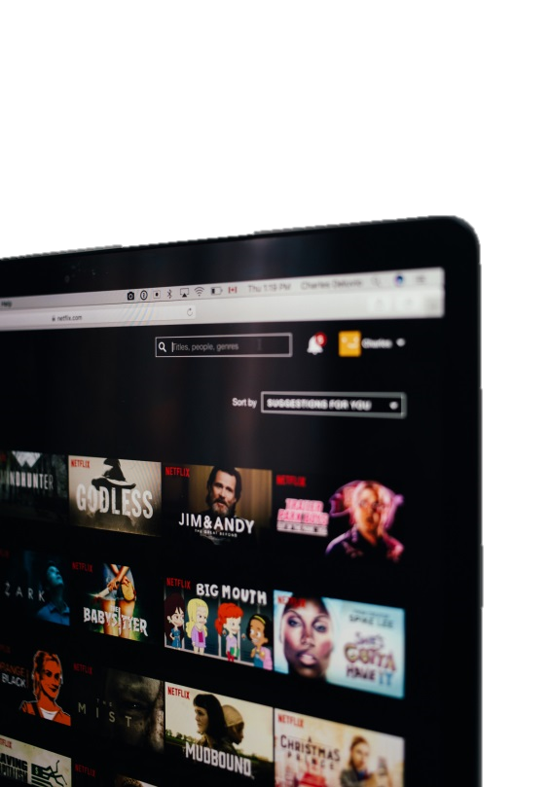
Video streaming
Percentage shares of OTT services used for video content consumption (in an average month)
Germany
Sweden

Slide 22
Music streaming
Germany
Sweden
Percentage shares of OTT services used for music content consumption (in an average month)

Slide 23
Case Study Sweden

Slide 24
Municipalities for success – Fibre roll-out in Sweden
6
Municipalities have been in the driver’s seat of fibre roll-out for 20 years now.
They feel a future-proof infrastructure can help retaining young affluent inhabitants.
Existing utility infrastructure was widely used to make fibre roll-out more efficient.
Open access is a key success factor as it leads to vibrant competition.
7
%
of municipalities in Sweden have deployed local fibre networks¹
1 Svenska Stadsnätsföreningen

Slide 25
Stokab connects 90% of all households in Stockholm
Direct Economic Impact¹
Founded in 1994, Stokab belongs to the City of Stockholm.
They provide access to physical infrastructure in the greater Stockholm area. Their wholesale-only model and market-driven roll-out have been key success factors.
This model is used throughout Sweden to drive fibre roll-out.
1
6
5
+
billion SEK
billion SEK
referring to direct investment and cost savings for the municipality and the national administration including benefits for private and business customers. An additional SEK 5 billion is from Stokab‘s procurement.
Indirect Economic Impact¹
7
.
7
billion SEK
referring to innovative services and products being developed and used in the area due to fast broadband access as well as increased productivity and entrepreneurship.
1 Forzati / Mattson (2013): STOKAB, a socio-economic analysis

Slide 26
Fibre’s impact in rural areas in Sweden
Skellefteå
Hudiksvall
Skellefteå is a small city with a population of 33,000 in the North of Sweden.
The goal of its Sense Smart Region is to build a comprehensive network of sensors that enable various augmented reality applications.
The project is present through various seminars in the region and beyond.
ICT innovation and fibre access have recently attracted Northvolt (Europe’s largest lithium-ion battery producer) and Amazon to the area.
The widespread availability of FTTH in Hudiksvall enables various new eHealth services.
The eHealth services featured as part of the pilot cover a video communication service, digital alarm and night supervision. The pilot will also deploy an open digital social care alarm platform.
The involvement of the municipality in offering fibre infrastructure enabled also an increase in the social benefits of the pilot as patients on homecare were offered free access.
Source: Connected for Health Newsletter

Slide 27
Case Study Nuenen (NL)

Slide 28
Nuenen – An FTTH first mover
Nuenen was one of the first municipalities in the Netherlands to roll out FTTH.
They started as early as 2005. Within 3 months a 97% take-up rate had been achieved.
The cooperation model and strong personal involvement at the local level were the key success factors for this quick roll-out and high take-up.
This strong local involvement is still part of fibre networks in the area. It also increases the social benefit of FTTH in the area above and beyond the advantages of a fast broadband connection.
OnsNet in the beginning
Initially OnsNet was a local cooperation and formed a sense of community in Nuenen that drove commitment to purchase FTTH Internet access. Reggefiber rolled out FTTH across the Netherlands in a similar manner. Citizens in Nuenen started with 10 Mbit/s symmetric access in 2005 including telephone and email. The Dutch government subsidised each connection to the value of €800.
OnsNet today
KPN bought Reggefiber in 2014. In July 2017 KPN Reggefiber took control of the OnsNet Nuenen cooperation thus offering a more compelling and efficient service provision. Nonetheless, the cooperation still has a monitoring function. They track KPN’s annual reports and have a say in management decisions. Furthermore, citizens of Nuenen can join management and engineers at meetings to bring in new ideas. Thus the community is still involved which yields additional benefits of social cohesion.

Slide 29
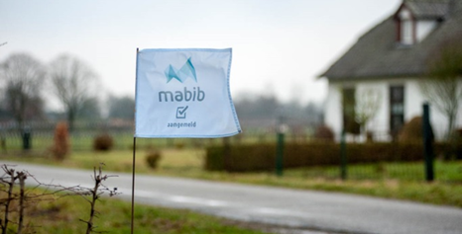
How to access rural areas with FTTH?
The FTTH initiative has been hugely successful in Nuenen. However, there is still a lack of fast Internet access in the surrounding rural and remote areas.
A conspicuous marketing campaign uses a pink cow and Mabib flags to indicate homes already signed up for the FTTH connections to be installed in 2018.
Data-intensive agricultural companies are signing up for FTTH as well as citizens who currently have no Internet access at all.
Pictures: Mabib.nl

Slide 30
How to access rural areas with FTTH?
Precision farming enables all equipment to be GPS guided and responsive to the specific soil conditions.
This requires collection of large amounts of data from multiple locations and then (often cloud-based) central processing to compare the specific farm with other farms.
In the Nuenen area some farmers connected their farms already by digging their own trenches and laying fibre.
The remaining farmers strongly supported the initiatives to bring FTTH to the rural and remote areas around Nuenen.
Picture: Kees Streefkerk

Slide 31
An Outlook

Slide 32
Two trends shape future demand for bandwidth
Tactile Internet
Immersive media
Tactile Internet refers to a futuristic telecommunications infrastructure which will feature very low latency, ultra high reliability and availability as well as high security standards. It will facilitate the introduction of new and innovative technologies and shape the future of human–computer interaction.
Individuals will be able to fully immerse themselves in virtual realities in the future, so that the line between reality and fiction likely blurs. Such an experience requires humans to receive realistic feedback via all their senses. Thus latency has to match human reaction times. Immersive media is therefore subject to high broadband requirements which will only be met by Tactile Internet infrastructures.
Source: For an overview of Tactile Internet, see Maier, M. et al. (2016). The Tactile Internet: Vision, Recent Progress, and Open Challenges. IEEE Communications Magazine, 54(5), 138–145; ITU (2014). The Tactile Internet. ITU-T Technology Watch Report, Geneva.

Slide 33
Tactile Internet
Tactile Internet will enable real-time data transmission. Latency has therefore to resemble human reaction times:
The auditory reaction time is 100 ms
The visual reaction time is 10 ms
The haptic reaction time is 1 ms
New applications in sectors like healthcare, education, gaming and the automotive sector will rely on Tactile Internet:
Remote surgery or autonomous driving require high reliability and real-time data transmission with extremely low latency. Broadband failures or high latency might lead to severe injuries or even death.
Virtual and augmented reality should provide a fully immersive experience. However, delays will confuse users and disrupt the experience. They may also cause so-called “cybersickness”.¹
100 milliseconds
10 milliseconds
1 millisecond
Source: The figure is inspired by Fettweis, G. (2014), "The Tactile Internet – Applications and Challenges", IEEE Vehicular Technology Magazine, 9 (1), 140–145, p.142. Icons (from left to right): Gregor Cresnar, Carin Marzaro, Sergey Demushkin.
Source: The insights from this slide are from: Maier, M. et al. (2016). The Tactile Internet: Vision, Recent Progress, and Open Challenges. IEEE Communications Magazine, 54(5), 138–145; ITU (2014). The Tactile Internet. ITU-T Technology Watch Report, Geneva; ¹ ITU (2014). The Tactile Internet. ITU-T Technology Watch Report, Geneva, p.3.

Slide 34
Immersive media
Today’s virtual and augmented reality systems require 100 to 200 Mbit/s for a one-way immersive experience. Future applications, however, will likely require fully symmetric access of more than 1 Gbit/s.
A fully immersive experience will engage all senses. Therefore, latency of less than 1 ms is required.
Virtual and augmented reality will provide new opportunities in multiple sectors other than entertainment:
Virtual and augmented reality enables students to learn together in situ no matter where they are located. It also enhances cognitive and social skills.
Virtual reality enables remote diagnostics, therapy and surgery, from which individuals living in rural areas can benefit the most.
Source: The insights from this slide are from: Bastug, E. et al. (2017). Towards Interconnected Virtual Reality: Opportunities, Challenges and Enablers. IEEE Communications Magazine, 55 (6), 110-117; ABIresarch & QUALCOMM (2017). Augmented and Virtual Reality: The First Wave of 5g Killer Apps. NY, Oyster Bay; ITU (2014). The Tactile Internet. ITU-T Technology Watch Report, Geneva; Martín-Gutiérrez, J.; Mora, C. E.; Añorbe-Díaz, B. & González-Marrero, A. (2017). Virtual Rechnologies Trends in Education, EURASIA Journal of Mathematics Science and Technology Education, 13(2), 469-486.

Slide 35
Summary

Slide 36
Summary (1 of 3)
Study objective
This study investigates the socio-economic benefits of FTTH in Sweden and the Netherlands using a representative consumer survey and case studies.
Survey results
Consumers have been migrating to FTTH in Sweden since 2007, while the shares of subscriptions that rely on other technologies such as DSL and cable have decreased over the same period.
In Sweden over half of the contracts signed since 2014 have involved broadband connection speeds of more than 100 Mbit/s. In 2017 more than 40% of all Internet subscribers enjoyed high-speed broadband access of more than 100 Mbit/s.
The proportion of households in Sweden with Internet speeds of more than 100 Mbit/s has grown in rural areas in particular. The share rose from just 6% in 2014 to 47% in 2017.
Approximately 67% of all broadband connections that provide speeds of more than 100 Mbit/s in Sweden are based on FTTH. In rural areas this share rises to 82%.
For FTTH subscribers high bandwidth is the primary reason for purchasing an FTTH connection.

Slide 37
Summary (2 of 3)
On average Swedish FTTH broadband subscribers perform 11% more activities online than subscribers with other Internet access technologies, especially activities regarding entertainment or connecting with other people.
Swedes with high-speed Internet access use music and video streaming services significantly more frequently than Germans. 30% and 35% of Swedes watch videos and listen to music solely over the Internet. Only 10% and 21% of Germans are similarly drawn to online video and music streaming.
FTTH users are consistently more likely to own connected devices than non-FTTH users thus indicating a more progressive Internet usage pattern for FTTH users.
82% of FTTH customers say that they like their service very much or that it is above average. This is a substantially higher level of satisfaction than that recorded for any other Internet access technology in Sweden.
Almost all non-FTTH subscribers (94%) would subscribe to FTTH if it was made available in their area.

Slide 38
Summary (3 of 3)
Case study – Sweden
67% of municipalities in Sweden have deployed local fibre networks.
The Stokab roll-out has an overall economic impact of almost SEK 29 billion.
Distance learning is crucial in Sweden due to its size and low population density. FTTH enables education for all students regardless of their location. Massive open online courses (MOOCs) are very popular in Sweden.
Case study – Netherlands
Nuenen (in the Netherlands) started rolling out FTTH in 2005. Within 3 months a 97% take-up rate had been achieved. However, there is still a lack of fast Internet access in rural and remote areas around Nuenen.
The increasing digitalisation of the agriculture sector in Nuenen places extreme demands on broadband connections. Fast broadband is required to support several applications and to collect, save and evaluate the data that has been gathered.

Slide 39
Contact
Dr. Iris Henseler-Unger
General Manager and Director
WIK-Consult GmbH
Rhöndorfer Str. 68 53604 Bad Honnef
Tel.: +49 2224 92 25 10 Fax: +49 2224 92 25 68
email: i.henseler-unger@wik-consult.com homepage: www.wik-consult.com
More insights:
Wernick, C, F Queder, S Strube Martins, & C Gries. 2017. Ansätze zur Glasfaser-Erschließung unterversorgter Gebiete. Bad Honnef: WIK-Consult. Wernick, C, S Strube Martins, C Bender, & C Gries. 2016. Markt- und Nutzungsanalyse von hochbitratigen TK-Diensten für Unternehmen der gewerblichen Wirtschaft in Deutschland. Bad Honnef: WIK. Wernick, C, & C Bender. 2016. The Role of Municipalities for Broadband Deployment in Rural Areas: An Economic Perspective. Bad Honnef: WIK.

Slide 40
Methodology
The online survey for this study was conducted with a representative sample of 1018 consumers between 29 September 2017 and 2 October 2017 by the international market research institute YouGov. The results were weighted to draw representative conclusions for the Swedish population (age 18+). For the purposes of comparison a representative survey conducted in Sweden in 2014 by YouGov (n=1122) and a survey conducted on behalf of the FTTH Council Europe in Sweden in 2009 (n=167) were used. The sample of the present survey comprised the following participants:
Sex
Age
Female | Male
512 | 506
18–29 | 30–39 | 40–49 | 50–59 | 60+
199 | 162 | 169 | 161 | 327
Technology
DSL | Cable modem | Optical fibre | Wireless access | Other/Not sure/ No answer
83 | 124 | 412 | 184 | 215
In addition, case studies were conducted for cities of various sizes in Sweden and for Nuenen in the Netherlands. For these WIK-Consult used desk research as well as telephone and personal interviews with stakeholders in the municipalities considered.
Unweighted numbers.

