Slide 1
5G and Future of Fixed Wireless Access Nick Dewar VP, Products and Systems Engineering

Slide 2
Who is Telrad?
Founded in 1951
Global provider of telecommunications solutions
Publicly traded (TASE:TLRD)
Rich Experience in Fixed Wireless Access

Slide 3
Substantial 4G based FWA Global Customer Base
300+ customers in 150 countries
3+ million wireless links deployed
200+ customers in North America

Slide 4
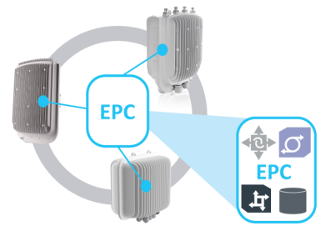
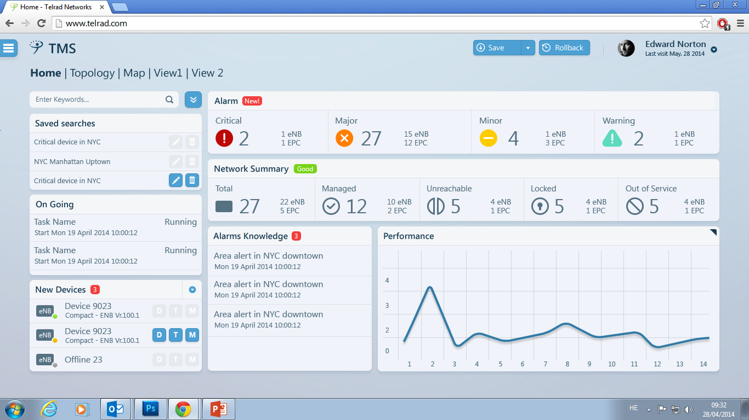
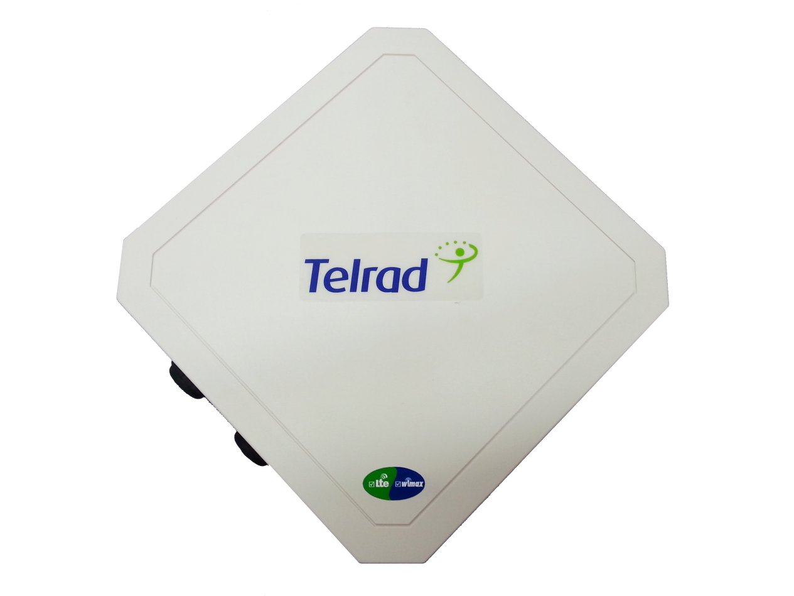
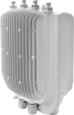
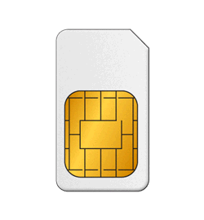
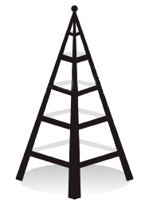
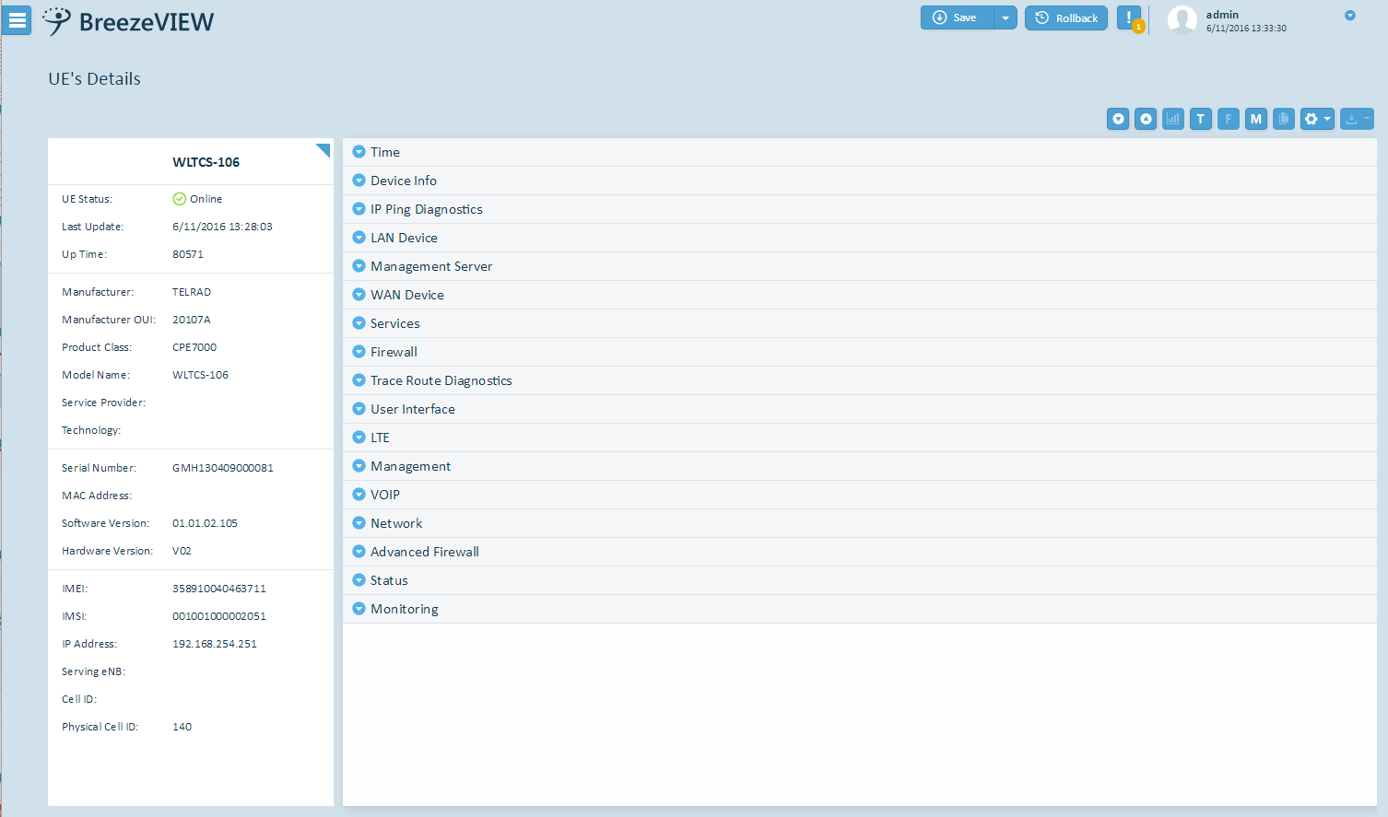
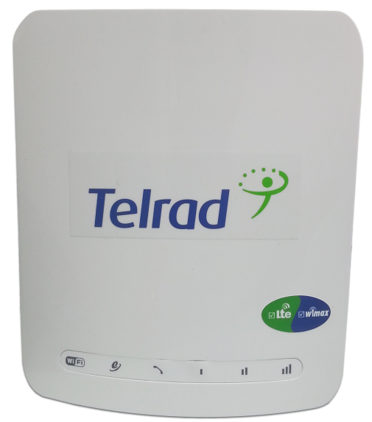
Telrad E2E Fixed BWA Solution
BreezeCOMPACT
eNodeB
Embedded EPC
BreezeWAY 1010
Network Management
Performance Management
UE Portfolio
CPE View (ACS)
Centralized EPC
BreezeWAY 2020
BreezeRADIUS
3rd Party HSS
PDN/ WWW
AAA

Slide 5
Path to 5G

Slide 6
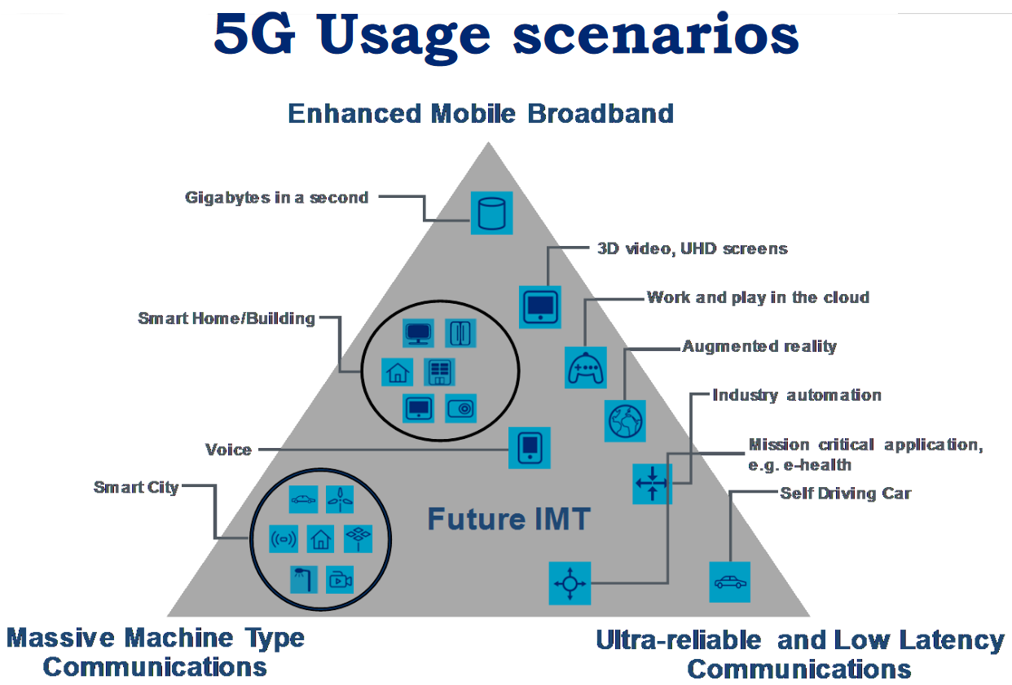
5G Use Cases

Slide 7
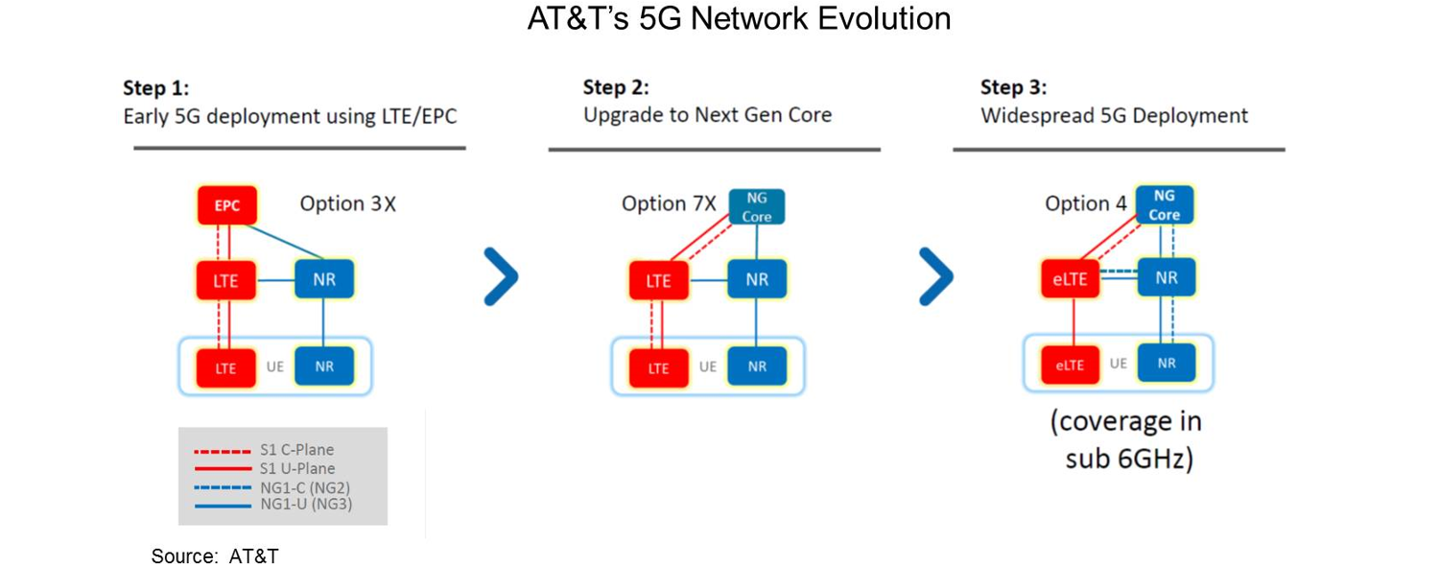
Early 5G – Non Stand Alone
Early 5G requires 4G anchor
Stand alone 5G standard recently finalized
5G device ecosystem will take time as will maturity. In meantime 4G is more than viable to address the digital divide

Slide 8
5G- NR eMBB Workplan

Slide 9
eMBB – Use Cases

Slide 10
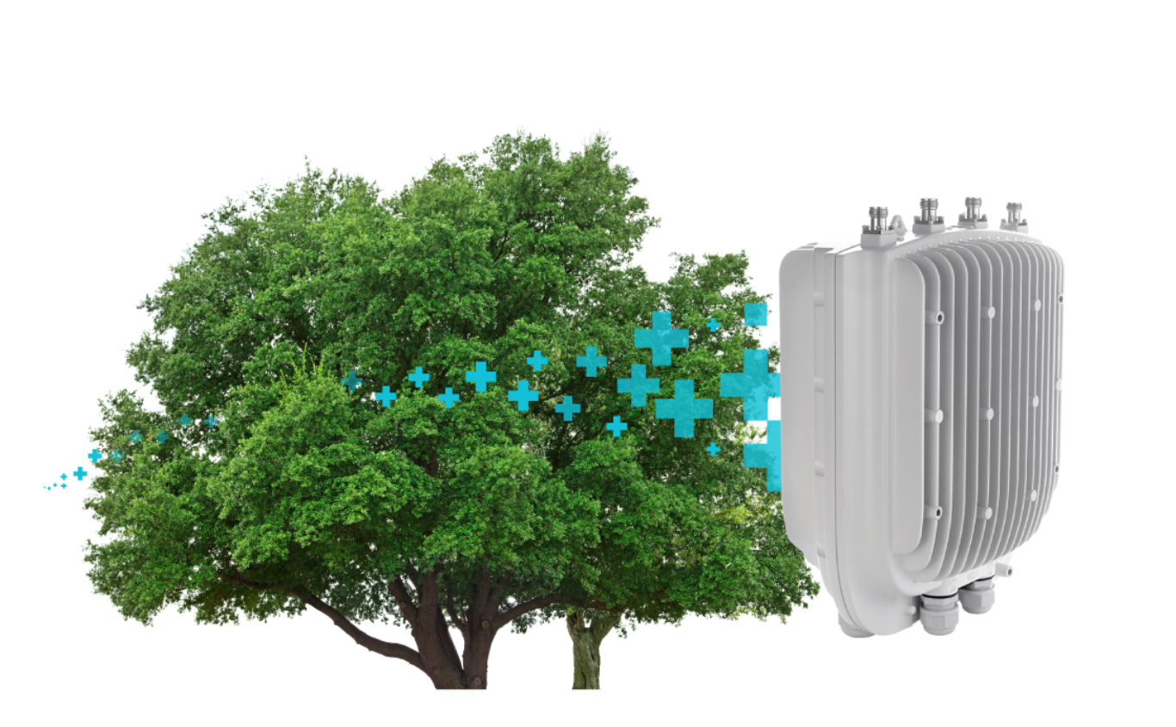
Rural Broadband Use Case
Rural Broadband Business case requires broad coverage footprint
Vegetation is often the largest obstacle in FWA
Same physics Apply to 4G and 5G

Slide 11
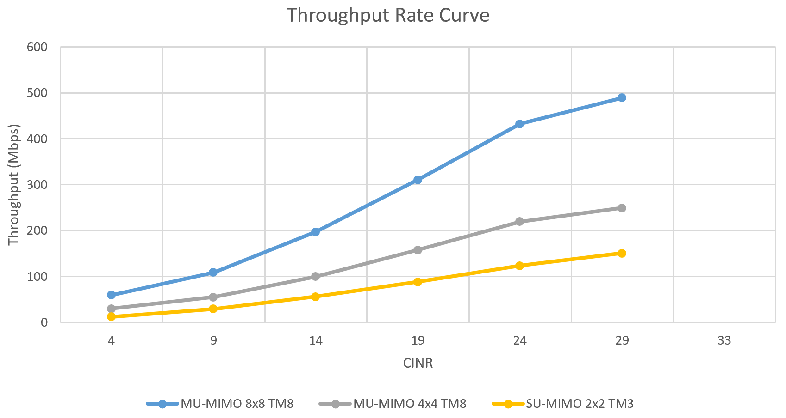
4G Spectral Efficiency
With good propagation spectral efficiency is higher making better use of the spectrum
Throughput per 20MHz channel using 8x8 with TM 8

Slide 12
Summary
Rural Broadband is required to extend connectivity to those who are otherwise unserved
Fixed Broadband use case often promoted in 5G marketing refers to Urban short range with high spectrum usage i.e. 400Mhz channels
400MHz channels are typical of mmWave but not realistic in sub 6GHz
mmWave can’t propagate through vegetation thus requires LOS
Sub 6GHz spectrum is a requirement to ensure Rural broadband operators can continue to service the otherwise unserved

Slide 13
Thanks

