Slide 1
Digital radio awaits us Filip Rožánek Strategic Development Analyst

Slide 2
DAB in brief
6/1995
First digital station in Norway (NRK Klassisk)
5/1999
First public test in the Czech Republic
4/2011
TELEKO launches regular DAB broadcasting in L-band
8/2013
Band III Consultation by Czech Telecommunication Office

Slide 3
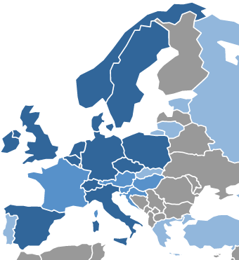
Situation in Europe according to WorldDMB
Regular service:
Belgium, Czech Republic, Denmark, Germany, Gibraltar, Ireland, Italy, Malta, Monaco, Netherlands, Norway, Poland, Spain, Sweden, Switzerland, United Kingdom
Trials and/or regulation:
Austria, Croatia, France, Hungary, Slovenia

Slide 4
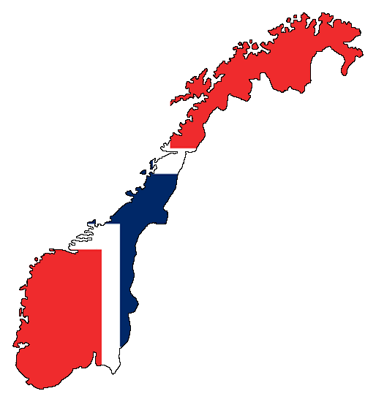
FM switch-off plans
Norway:
1/2017
Denmark:
2019
UK: 2015?

Slide 5
Czech Republic

Slide 6
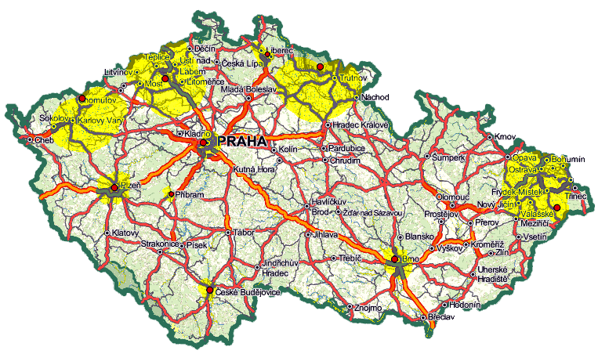
Current coverage (both L-band and Band III)

Slide 7
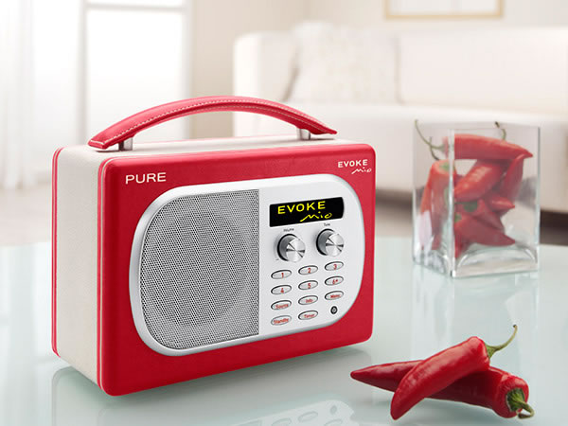
Czech Radio and digital broadcasting
DAB competes with:
DVB-S (since 1999)
DVB-T (trials since 2000, regular since 10/2005)
DVB-C
IPTV
WEB STREAMING (since 1996)
SMARTPHONES (Android, iOS, WP since 2010)

Slide 8
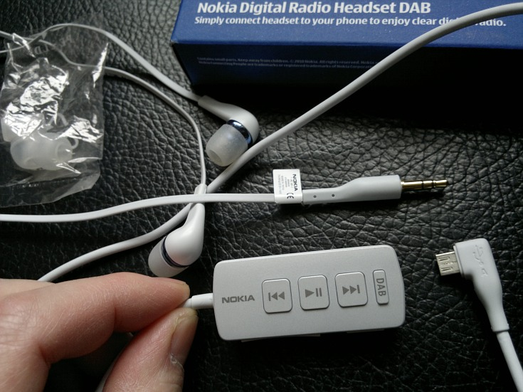
Why digital radio?
Wider choice of stations
Cheaper national coverage
New services
Better traffic information
Better sound
New business models

Slide 9
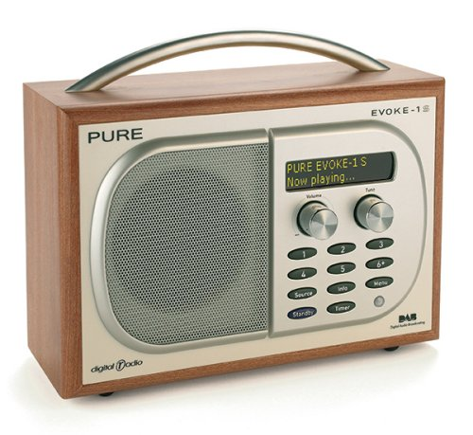
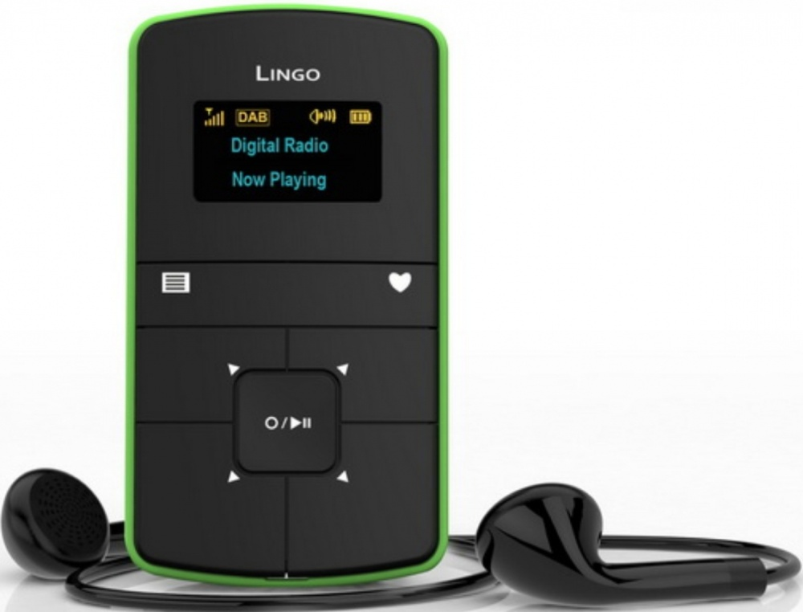
But…
We urgently need Steve Jobs!

Slide 10
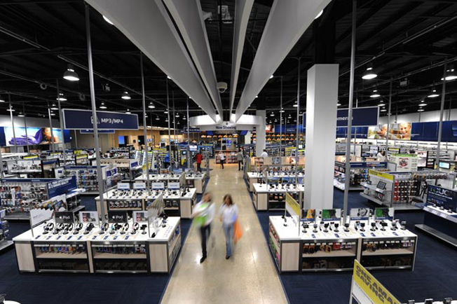
We need retailers! It‘s not easy to buy the digital radio receiver.

Slide 11
Any questions?
filip.rozanek@czechradio.cz
www.rozanek.cz

